Slide 1
Python Logging & Exception Handling
Venkata Shyam Kumar M

Slide 2
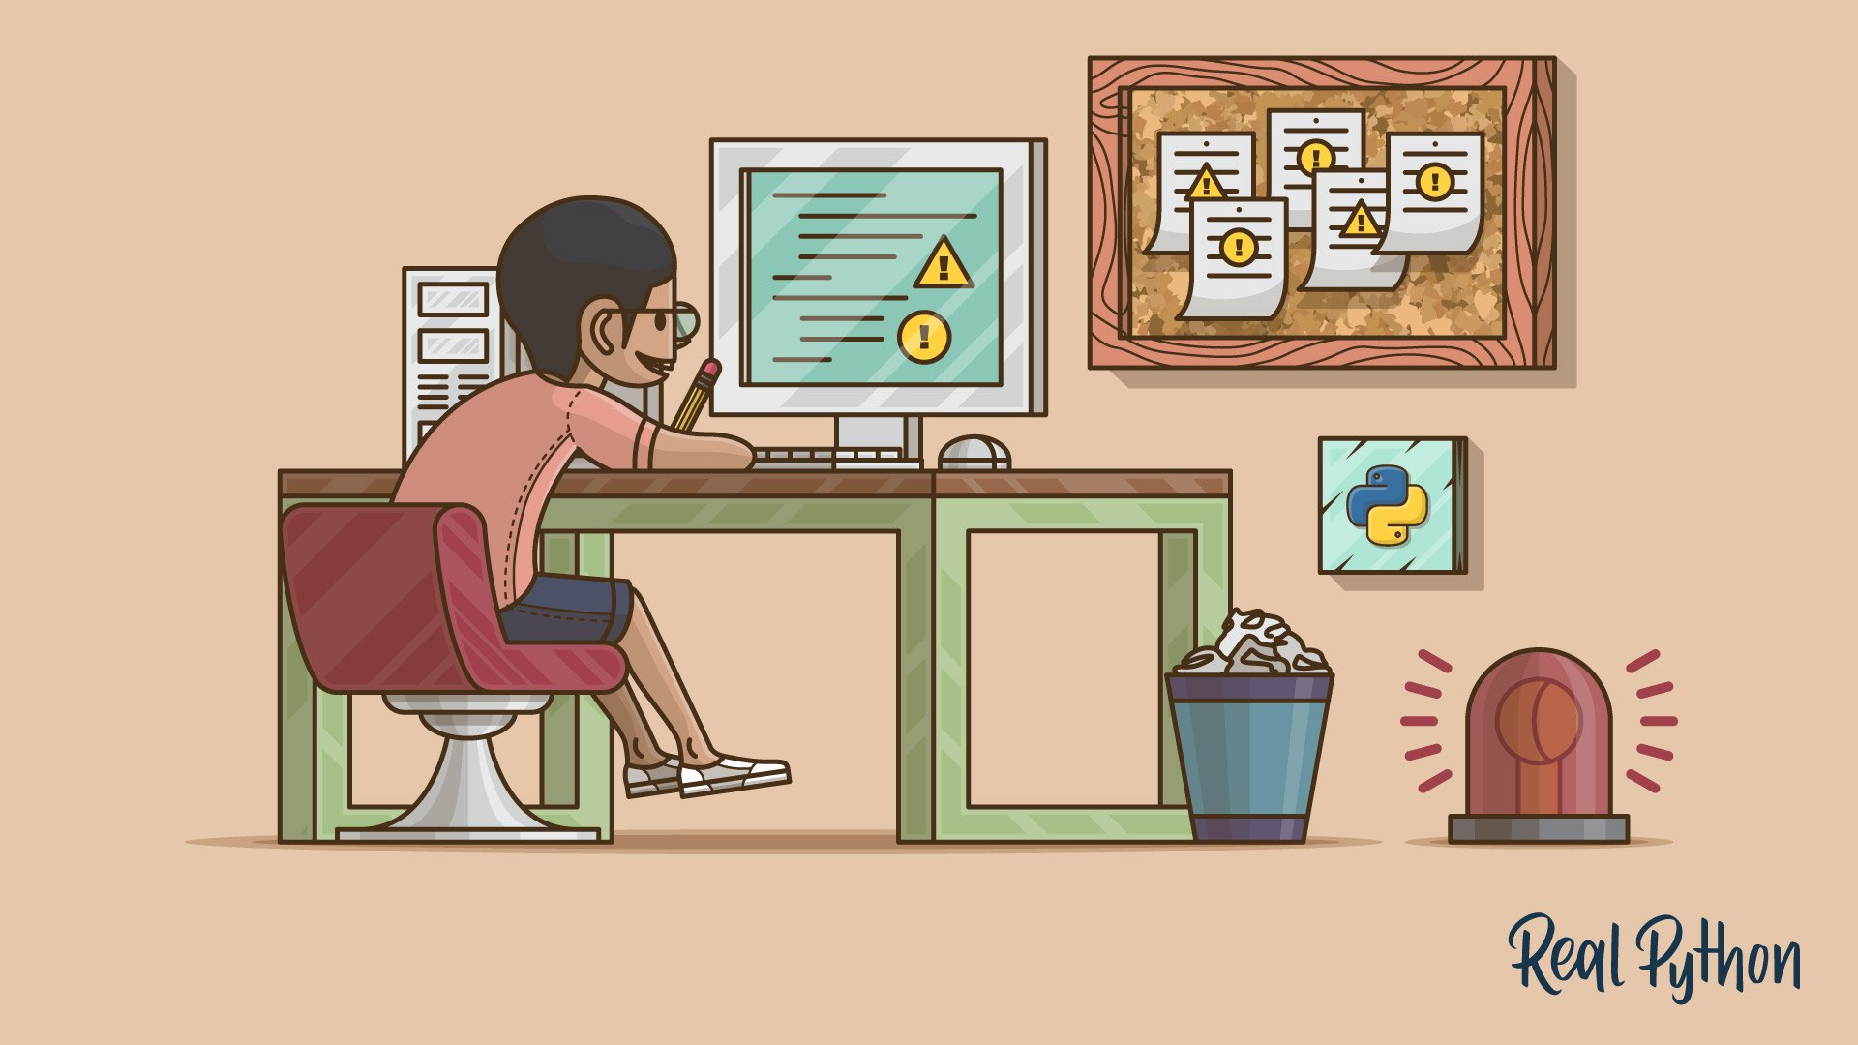
Agenda
Logging
The Logging Module
Basic Configurations
Formatting the Output
Logging Variable Data
Capturing Stack Traces
Classes and Functions
Using Handlers
Exception Handling
Exceptions versus Syntax Errors
Raising an Exception
The AssertionError Exception
The try and except Block
The else Clause
Cleaning Up After Using finally
Summing Up

Slide 3
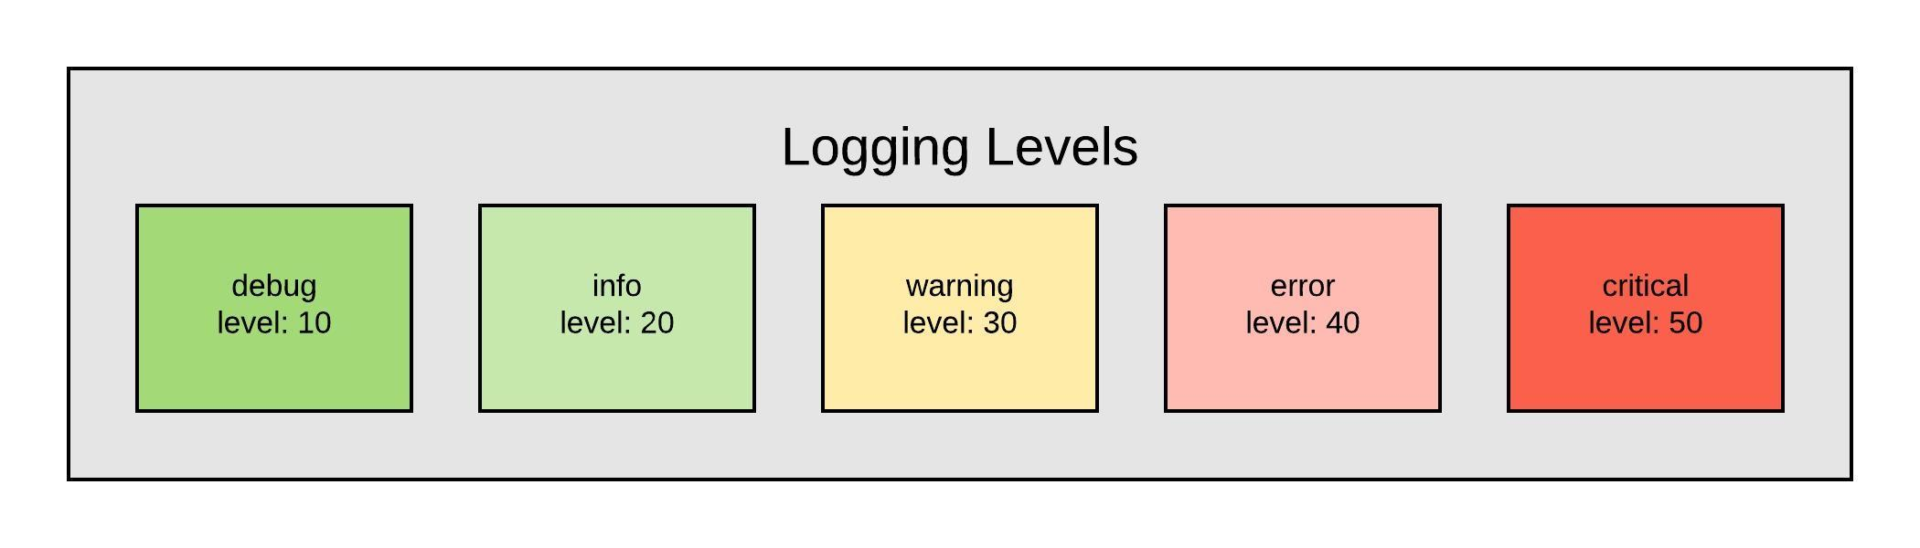
Logging
Logging develops a better understanding of the flow of a program
Helps debug errors easily
Adding logging to your Python program (standard library):
import logging
“logger” can be used to log messages that you want to see.
By default, there are 5 standard levels indicating the severity of events.
Arrays of object references

Slide 4
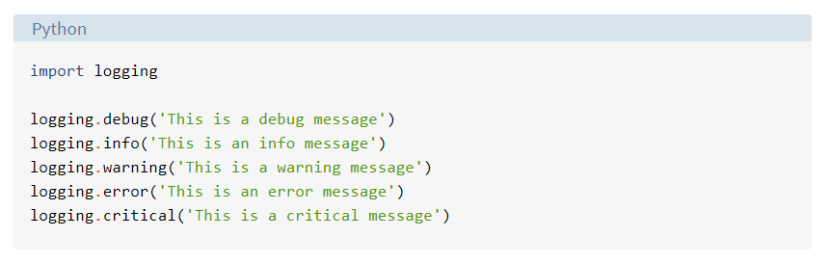
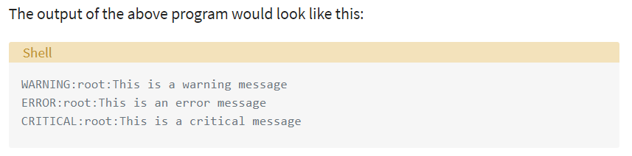
Default Logger and its output:
Arrays of object references
Syntax- SeverityLevel : DefaultLoggerName : Message
***By default, the logging module logs the messages with a severity level of WARNING or above.
4

Slide 5
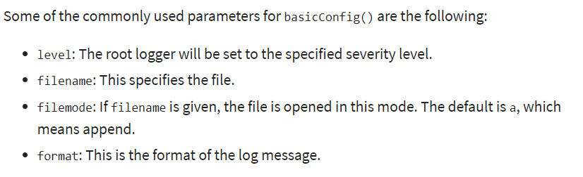
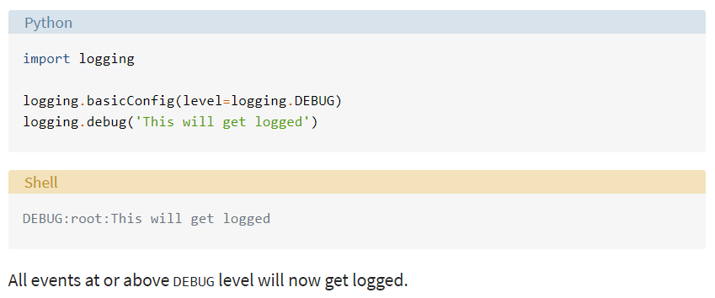
Basic Configurations
basicConfig(**kwargs) method to configure the logging

Slide 6
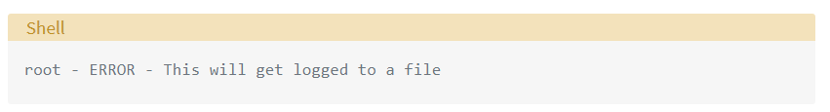
Basic Configurations Customization
Logging to a file → filename
Setting file mode → filemode (Default- a (append mode))
Formatting of the message→ format
The following example shows the usage of all three:
import logging
logging.basicConfig(filename=‘test.log', filemode='w’, format='%(name)s - %(levelname)s - %(message)s’)
logging.error('This will get logged to a file’)
basicConfig() customizations- link here.
format can take a string with any LogRecord attributes-link here.

Slide 7
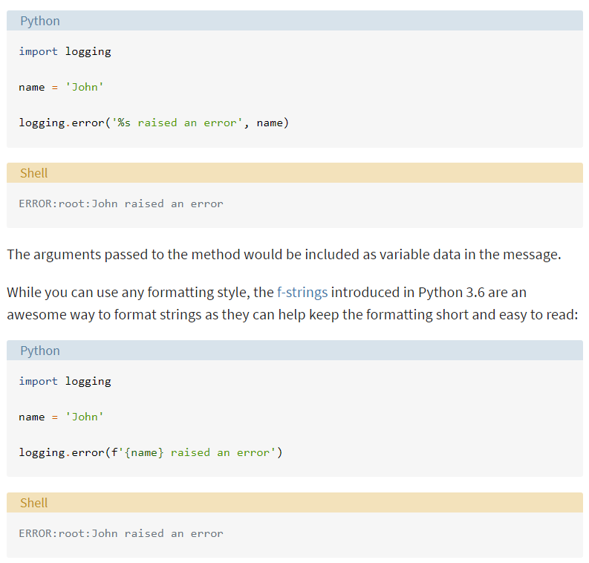
Logging Variable Data

Slide 8
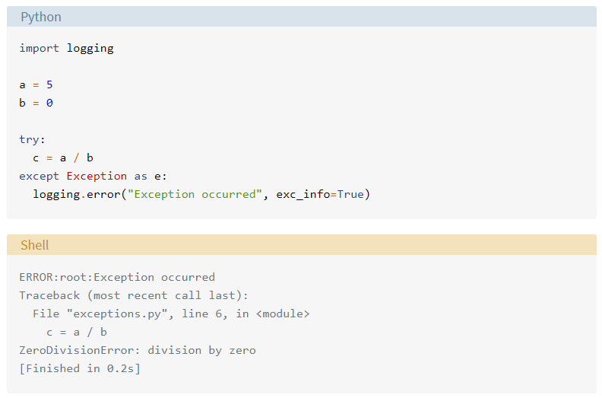
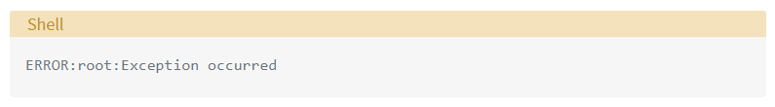
Capturing Stack Traces- exc_info=True
Output when exc_info is not set to True:

Slide 9
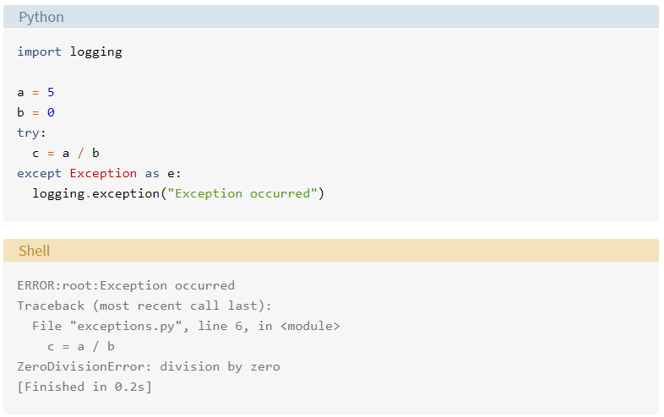
Capturing Stack Traces- logging.exception()
logging.exception() method→logs a message with level ERROR and adds exception information to the message. (=logging.error(exc_info=True))
It should only be called from an Exception handler.

Slide 10
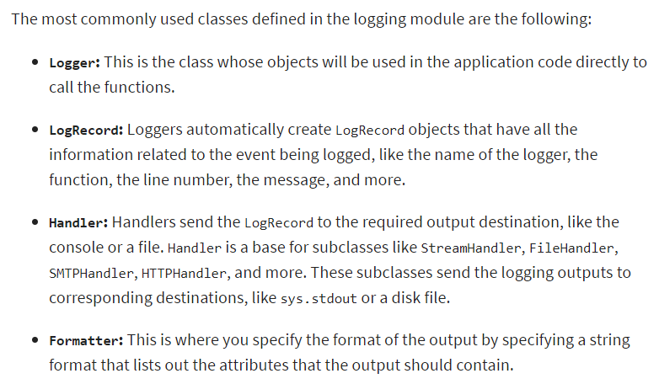
Classes and Functions
Define your own logger by creating an object/ instance of the Logger class, especially if your application has multiple modules.

Slide 11
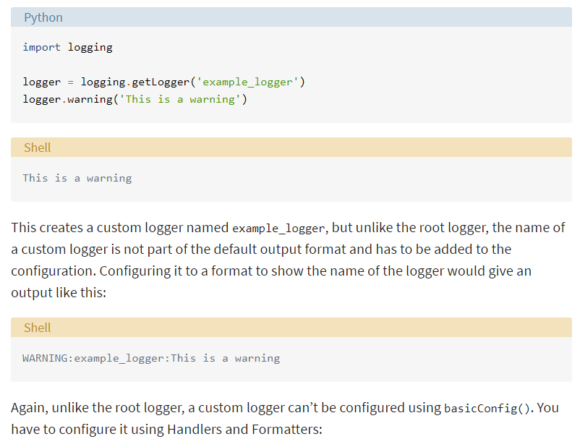
Logger Classes
Instantiated using the module-level function logging.getLogger(name).
Multiple calls to getLogger() with the same name will return a reference to the same Logger object → saves us from passing the logger objects to every part where it’s needed.

Slide 12
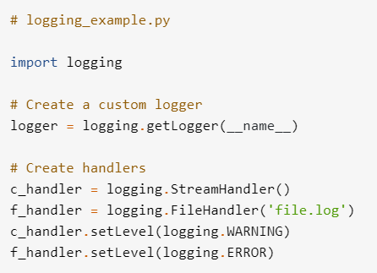
Handlers
Configure own loggers and send the logs to multiple places
Handlers can send the log messages to
standard output stream
file
over HTTP
oour email via SMTP.
A logger that you create can have more than one handler of different type

Slide 13
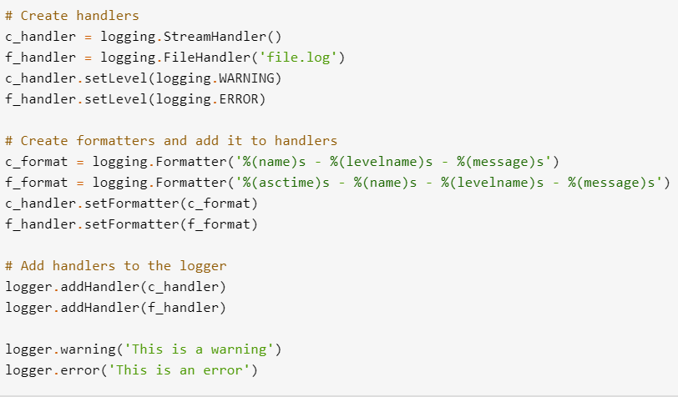

Handlers (Continued..)
File.log file content→
Console content →

Slide 14
Logging Assignments
1. Configure logging by creating a config file or a dictionary and loading it using fileConfig() or dictConfig() respectively.
2. Create a project with basicConfig() and set different format specifiers and observe the style in which the logging is printed for different severities
3. Create custom Handler and add it to your logger class and import this logger file into another file and perform the logging actions in that file and observe the logs
Link for reference- https://realpython.com/python-logging/

Slide 15
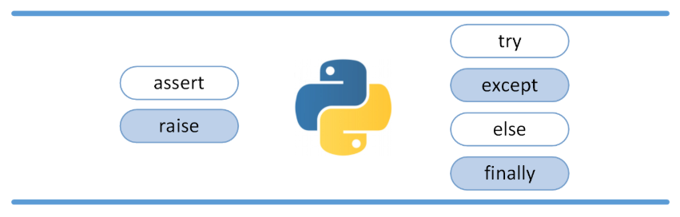
Python Exceptions
A Python program terminates as soon as it encounters an error.
In Python, an error can be a syntax error or an exception.
Arrays of object references

Slide 16
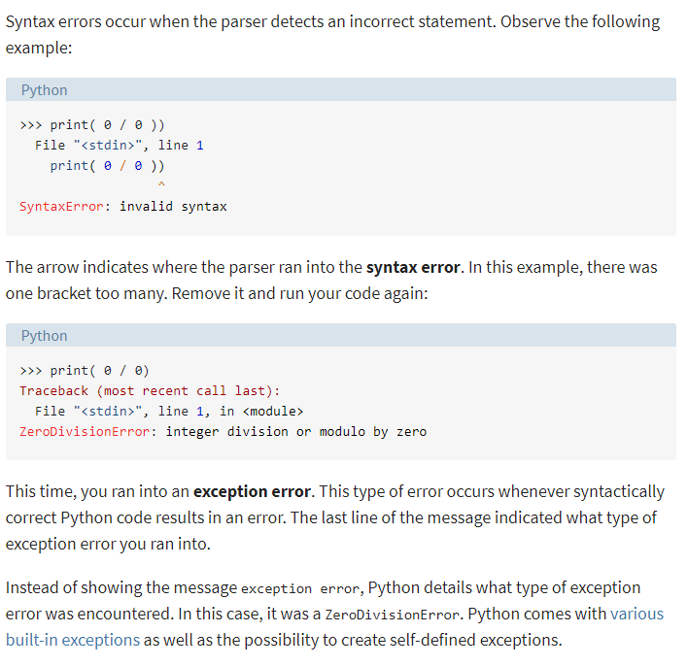
Exceptions vs Syntax Errors

Slide 17
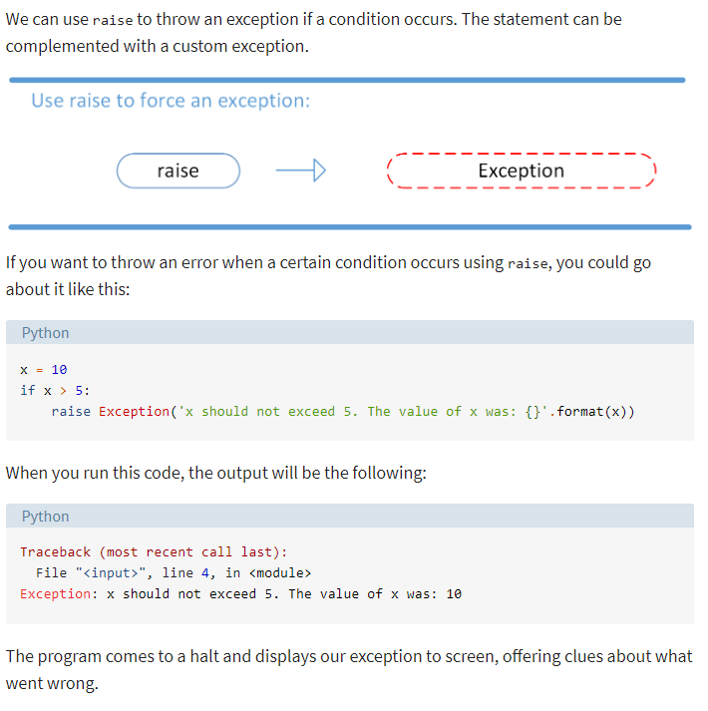
Raising an Exception

Slide 18
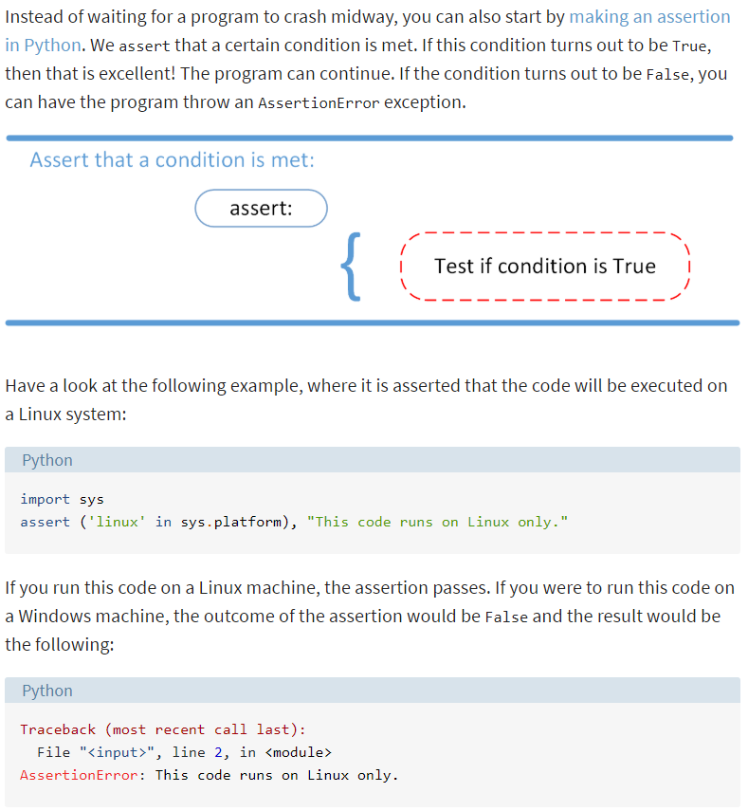
AssertionError Exception

Slide 19
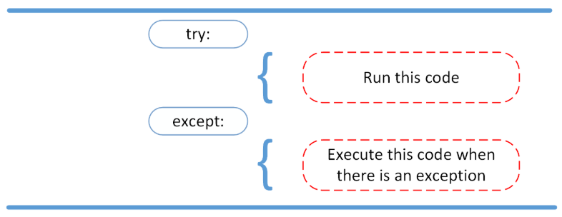
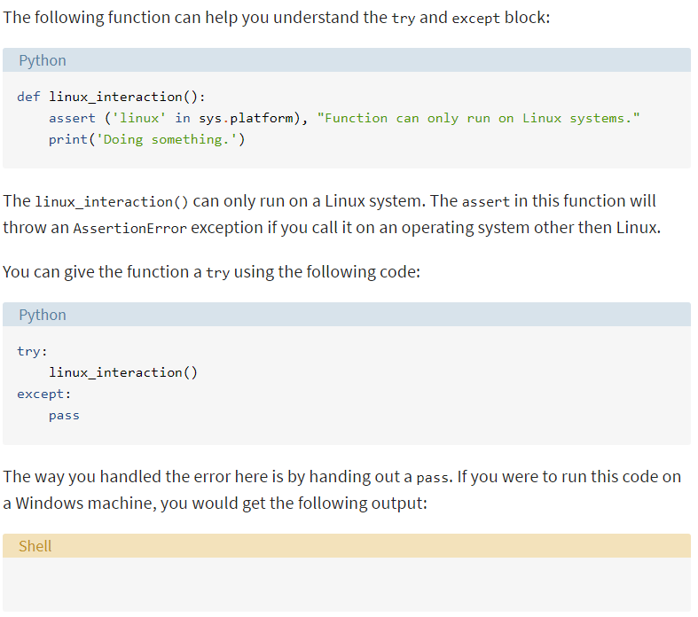
try and except Block: Handling Exceptions

Slide 20
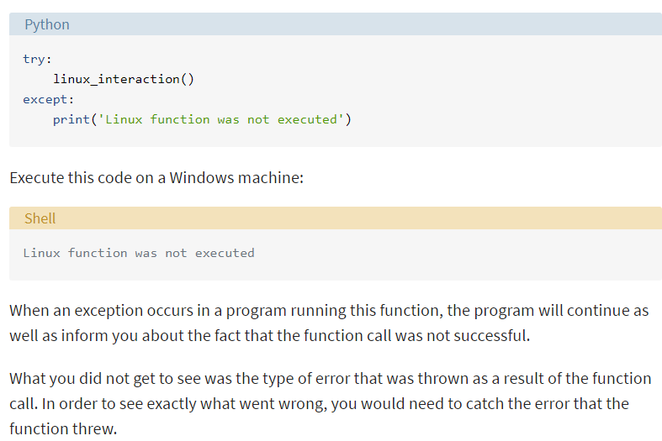
try and except Block: Handling Exceptions (Continued..)

Slide 21
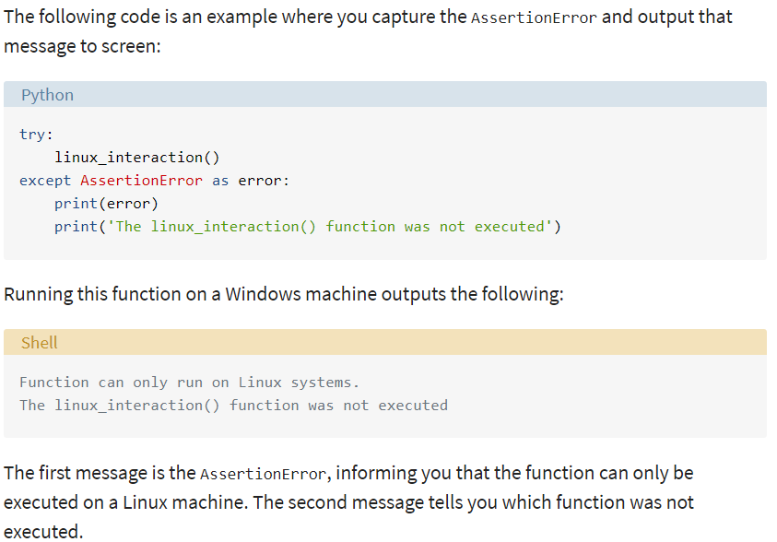
try and except Block: Handling Exceptions (Continued..)

Slide 22
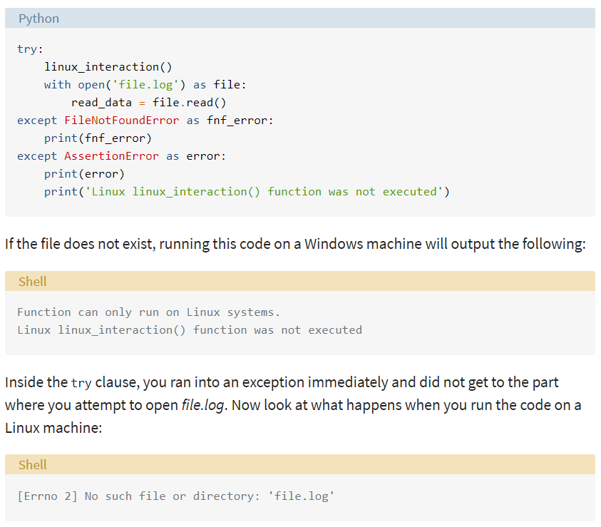
try and except Block: Handling Exceptions (Continued..)
You can have more than one function call in your try clause and anticipate catching various exceptions.
A thing to note here is that the code in the try clause will stop as soon as an exception is encountered.

Slide 23
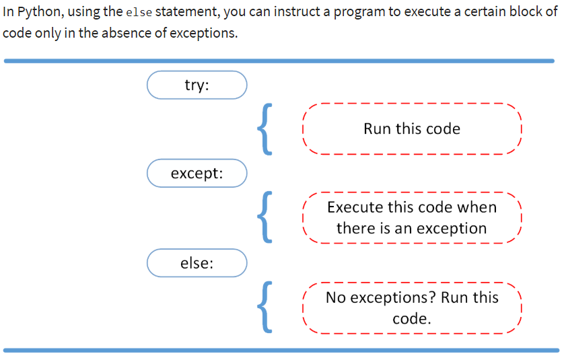
else clause

Slide 24
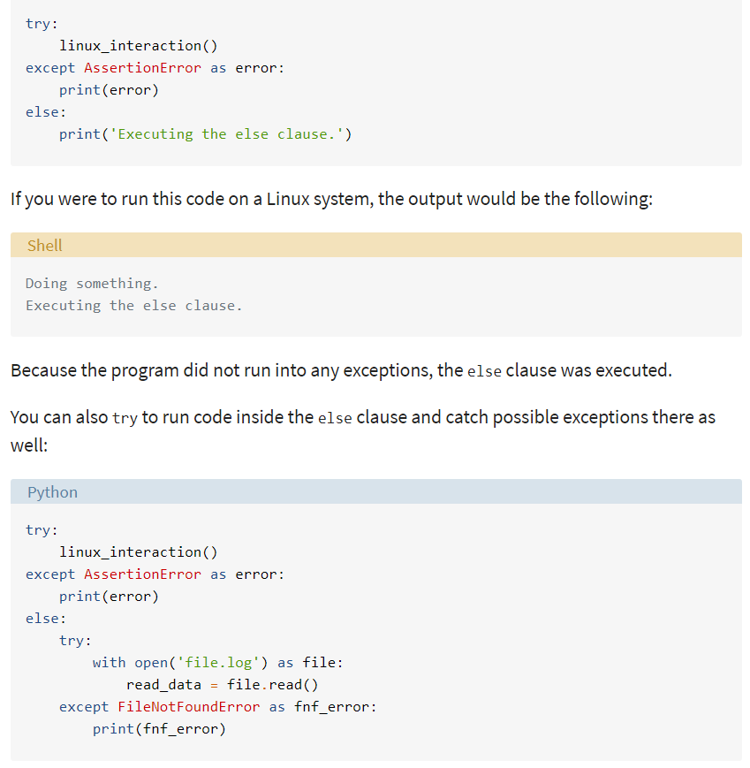
else clause (Continued..)

Slide 25
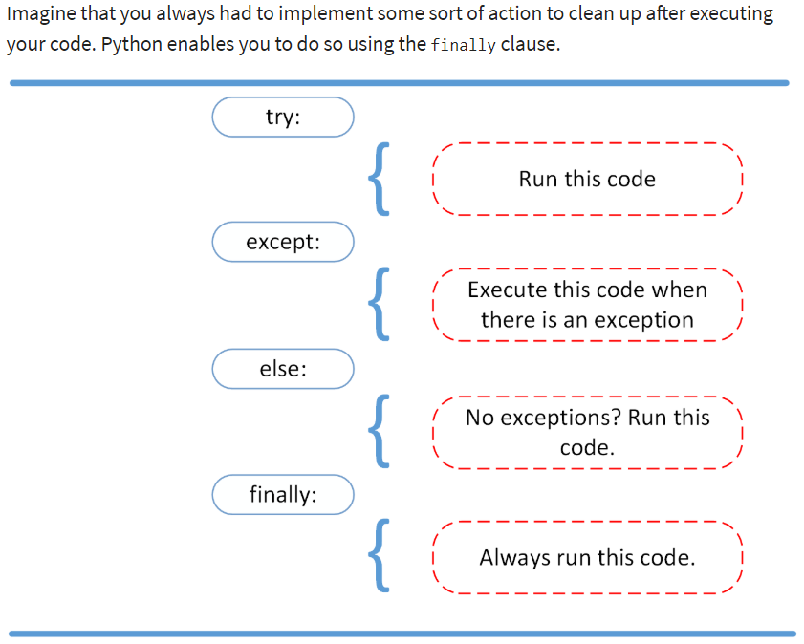
Using finally

Slide 26
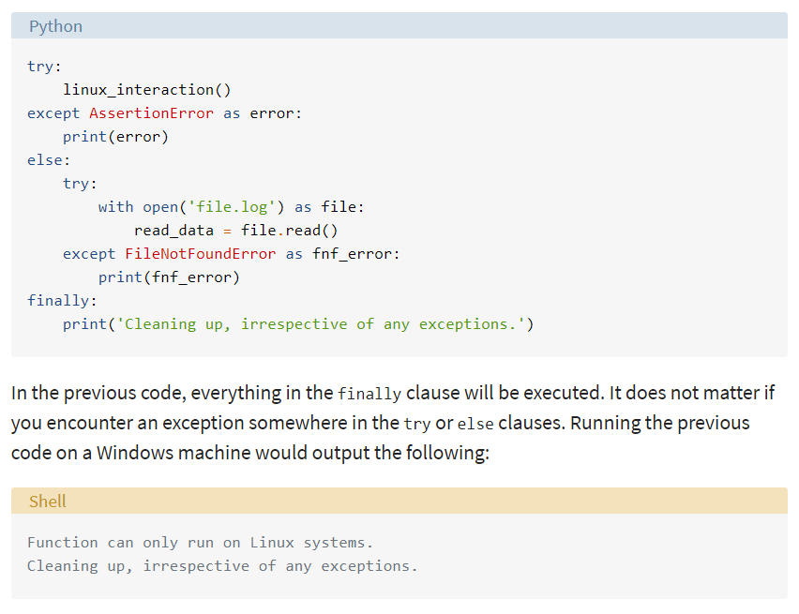
Using finally (Continued..)

Slide 27
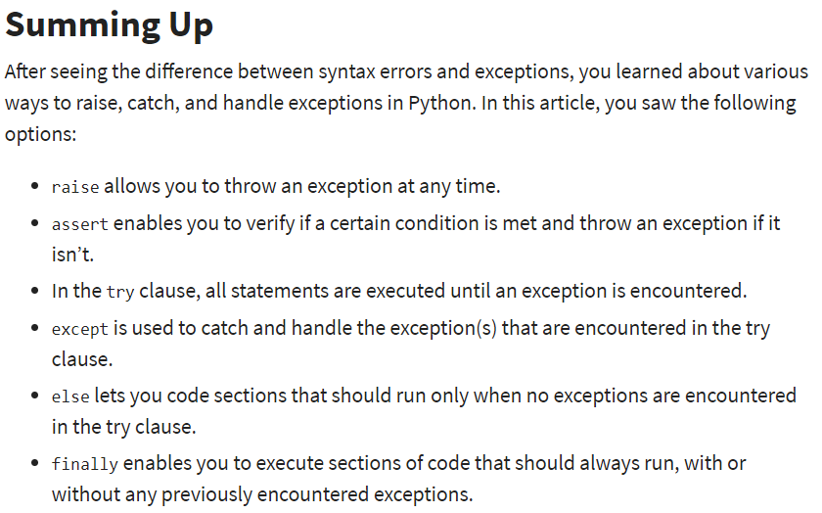

Slide 28
Exception Handling Assignments
Use Exception handling in all the methods/ functions that have been created by you so far and add try-except-else-finally block
Explore different exceptions available in python
Try to created your own exceptions and use them to catch the exceptions
Helpful links-
https://realpython.com/python-exceptions/
https://www.tutorialspoint.com/python/python_exceptions.htm
https://docs.python.org/3/tutorial/errors.html
Arrays of object references

Slide 29
References
https://realpython.com/python-logging/
https://docs.python.org/3/library/logging.html#
https://realpython.com/python-exceptions/
https://www.tutorialspoint.com/python/python_exceptions.htm
https://docs.python.org/3/tutorial/errors.html
Arrays of object references

Slide 30
Thank you

